Slide 1
Migration to the US
By Muhammad Tallal

Slide 2
Problem Statement
Person moving to or extending his business to a different country
He wants to make an informed decision to decide which city to move to
He will move to a city which is closest to his current city based on venues

Slide 3
Use Case
Person is moving to the US from Toronto
He is confused between New York and Chicago
He needs to make an informed decision based on venues which city is closest to his current city

Slide 4
Methodology
Neighbourhood data of the three cities is used to get venues of the neighbourhoods using Foursquare api
Neighbourhoods are classified into clusters based on the similar venues in different neighbourhoods of the different cities
Two different analysis are performed, one with Toronto and New York and other with Toronto and Chicago
Results are displayed as coloured clusters of map

Slide 5
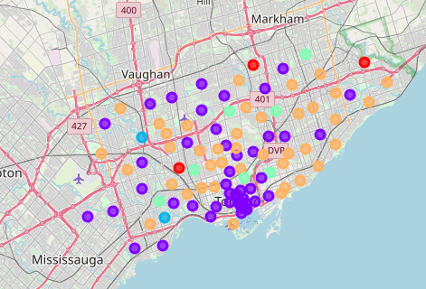
Results
Toronto in NY-Toronto comparison:

Slide 6
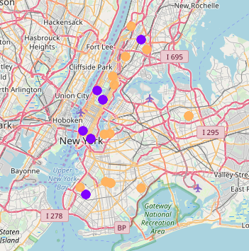
Results
New York in NY-Toronto comparison:

Slide 7
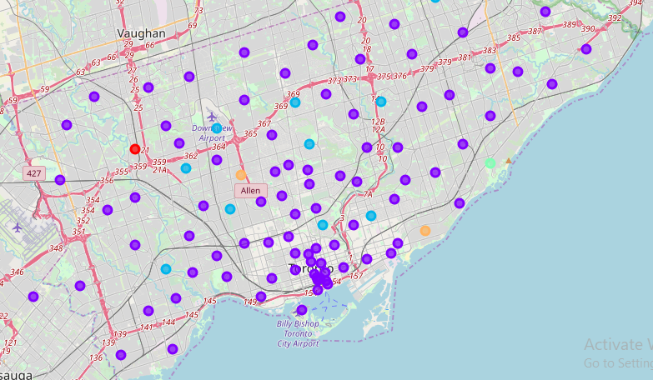
Results
Toronto in Chicago-Toronto comparion:

Slide 8
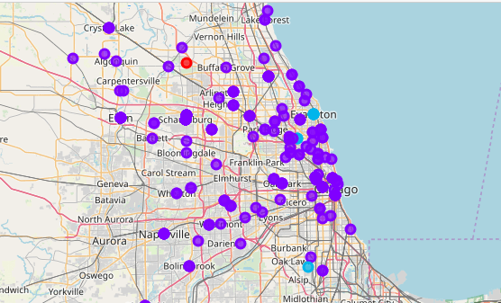
Results
Chicago in Chicago-Toronto comparison:

Slide 9
Conclusion
Results show that Chicago is more closer to Toronto rather than New York
Person moving to the US or extending his business to the US from Toronto should move to Chicago rather than New York if he is to base his decision on the venues in the city
This project can be extended or modified for similar use cases where comparison of different cities or countries are required and displayed visually

